Slide 1
JavaScript
Module 03
Notes:
This unit is all about introducing ourselves to using JavaScript to apply logic and make our applications feel more dynamic.

Slide 2
What do we use HTML and CSS for?

Slide 3
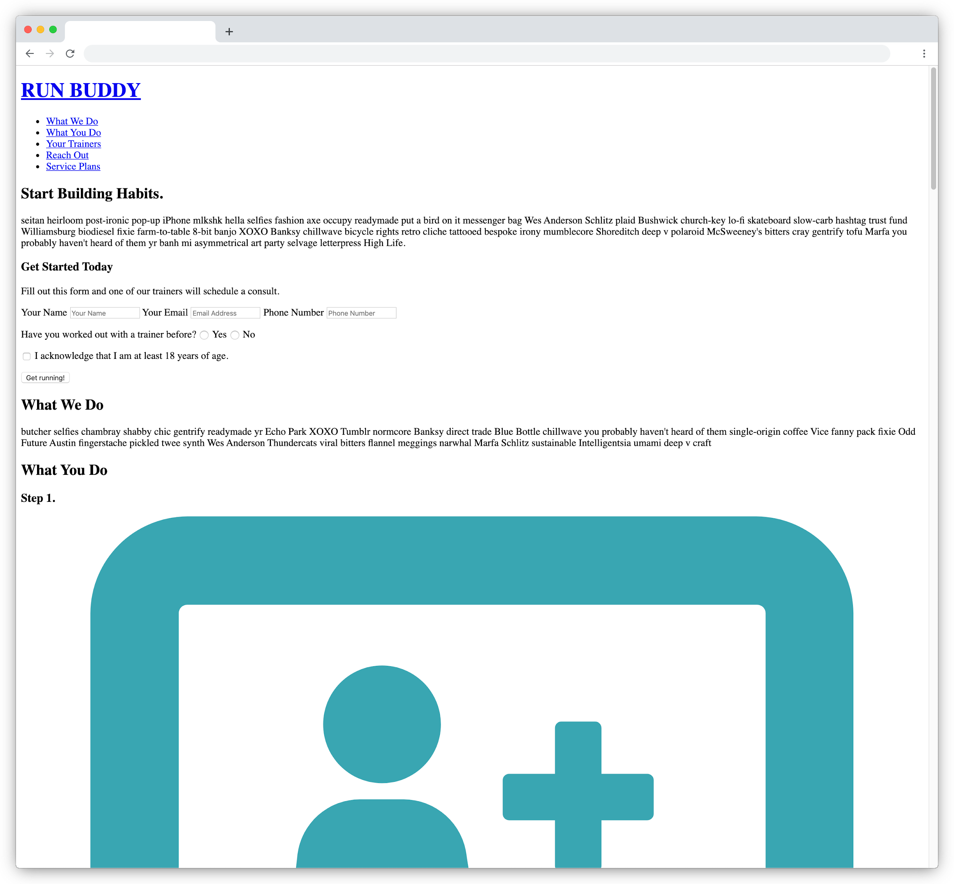
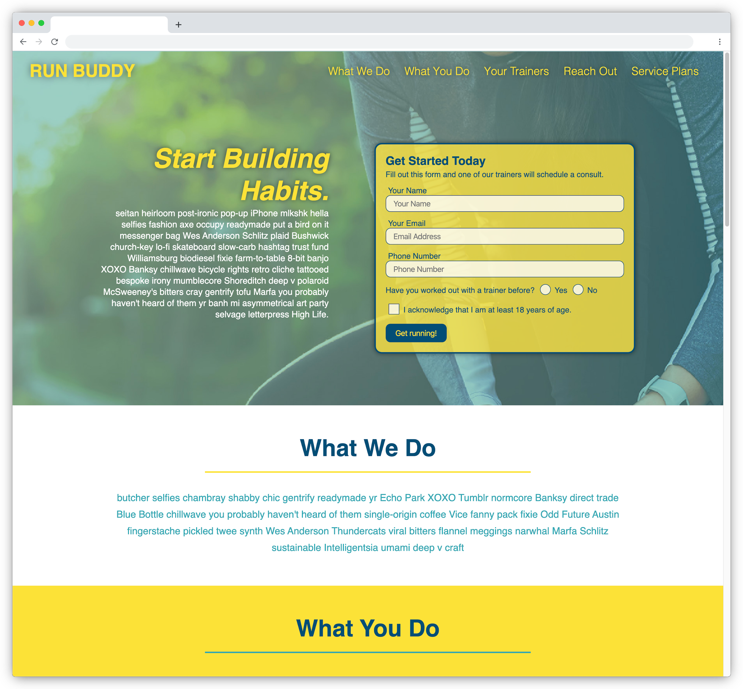
HTML & CSS: Languages of the Web
We use HTML to create and organize content on a page and CSS to apply styles, layout, and even animation to that content.

Slide 4
What are some examples of how users interact with a webpage?

Slide 5
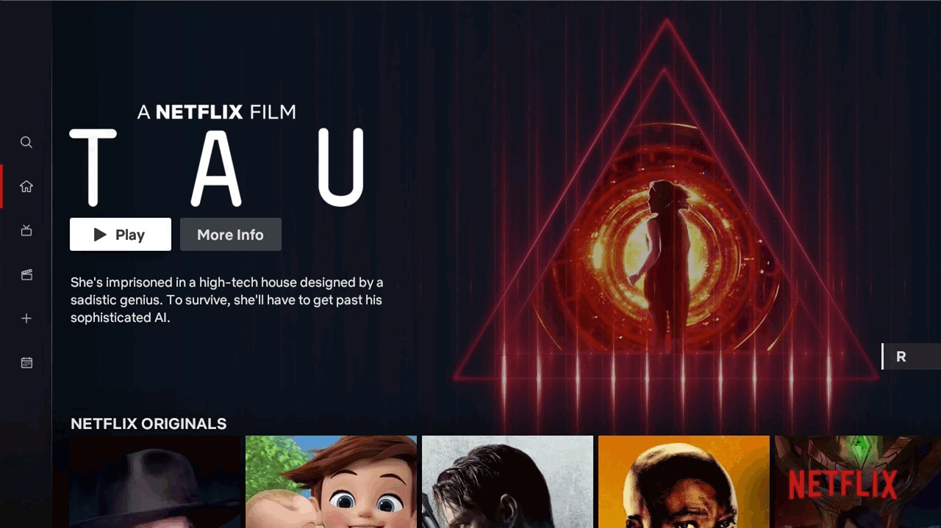
Interaction on Webpages
We interact with webpages in many ways on a daily basis.
Typically the webpage will respond or react to these interactions, making the page feel more dynamic and alive.
(Netflix: See What’s Next ... on TV)
Notes:
What is an interaction explainer.

Slide 6
Interaction Examples

Slide 7
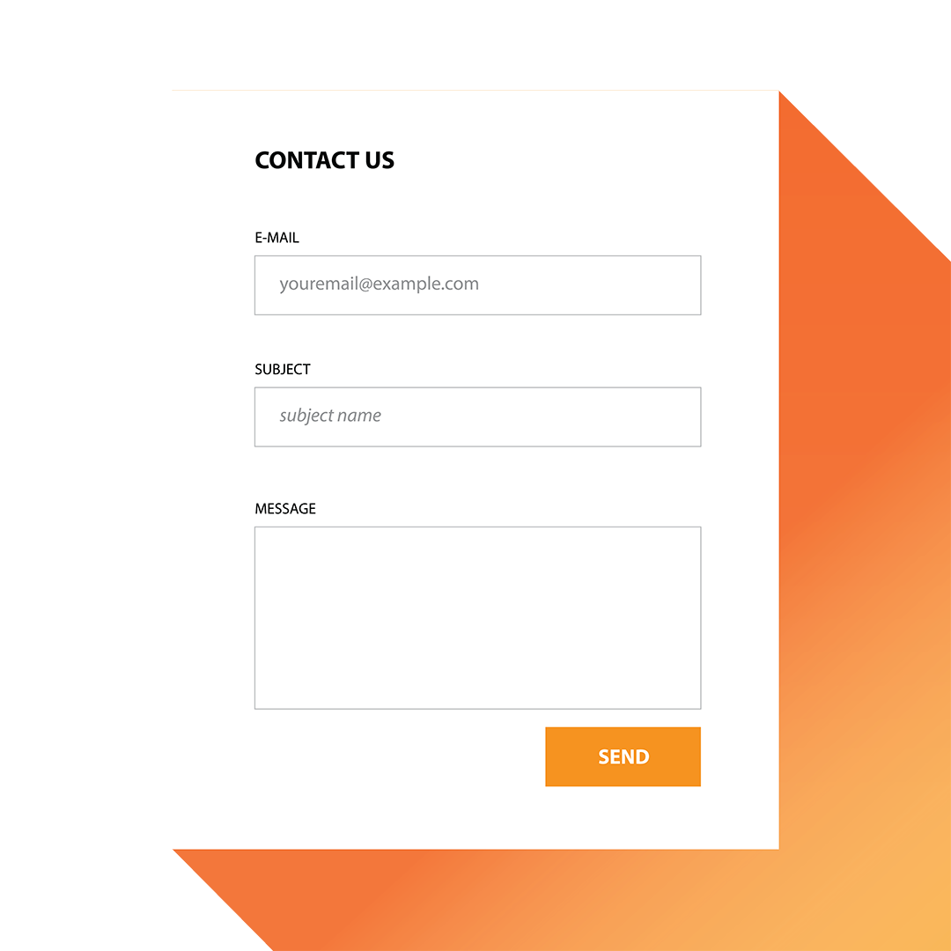
Interaction Examples
Submitting an HTML form to comment on an article.
Notes:
shutterstock_289057028.png

Slide 8
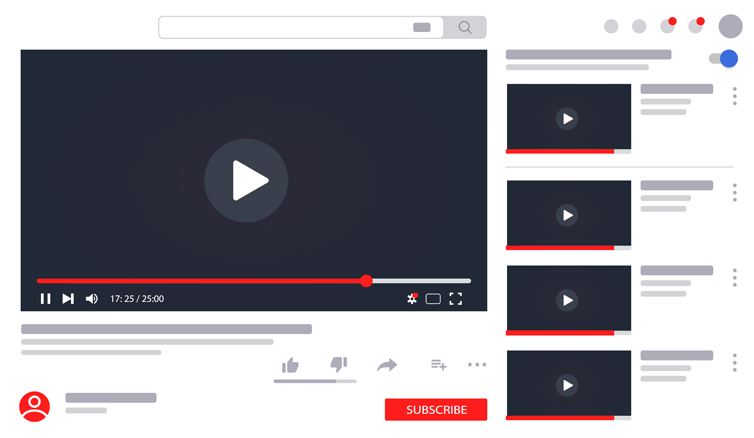
Interaction Examples
Playing audio or video at the press of a button on the page.
Notes:
shutterstock_1488096026

Slide 9
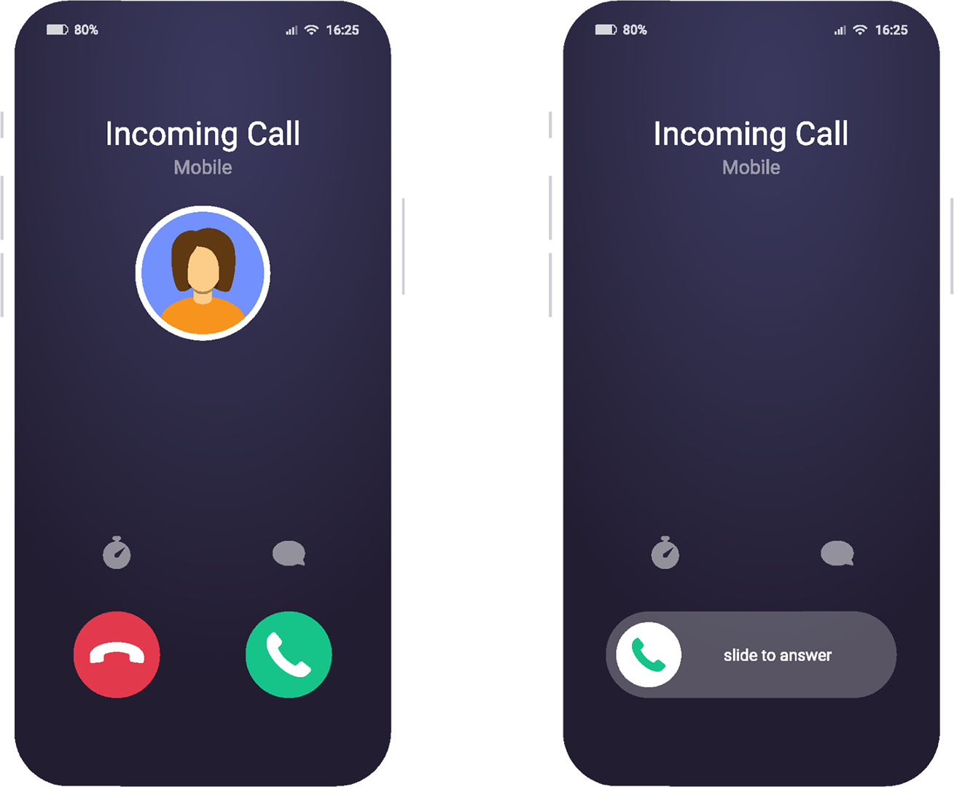

Interaction Examples
Using the device’s camera or microphone to enable a conversation.
Marie
Notes:
shutterstock_1824706049.png

Slide 10
Can we achieve these types of interactions using only HTML and CSS?

Slide 11
HTML & CSS ≠ Functional
While HTML and CSS offer some great built-in features that give users a sense of interaction or functionality on a site, they cannot handle the complex tasks that occur in response to these interactions.
HTML (Structure)
CSS (Presentation)
<p>
Hello, World!
<em>
text
Hello, World!
Hello,
World!
Hello, World!

Slide 12
For that reason, web developers utilize another programming language specifically designed for these tasks.

Slide 13
JavaScript is a programming language originally created to be run in the browser with the intention of enhancing a webpage’s capabilities. Today, nearly every page we visit on the internet depends heavily on JavaScript to work.

Slide 14



JavaScript
While HTML and CSS handle content and design, JavaScript handles the overall functionality of the application to make it feel more alive and dynamic.
HTML | CSS | JavaScript
Used to write content. | Used to format content. | Used to create dynamic web applications that take in user inputs, change what’s displayed to users, animate elements, and much more.

Slide 15
In what ways do we use JavaScript?

Slide 16
Front-end developers use JavaScript primarily to dynamically affect a webpage to enhance the user’s experience. No other programming language can run in the browser, so JavaScript is a must-have skill for web developers.

Slide 17
JavaScript Examples

Slide 18
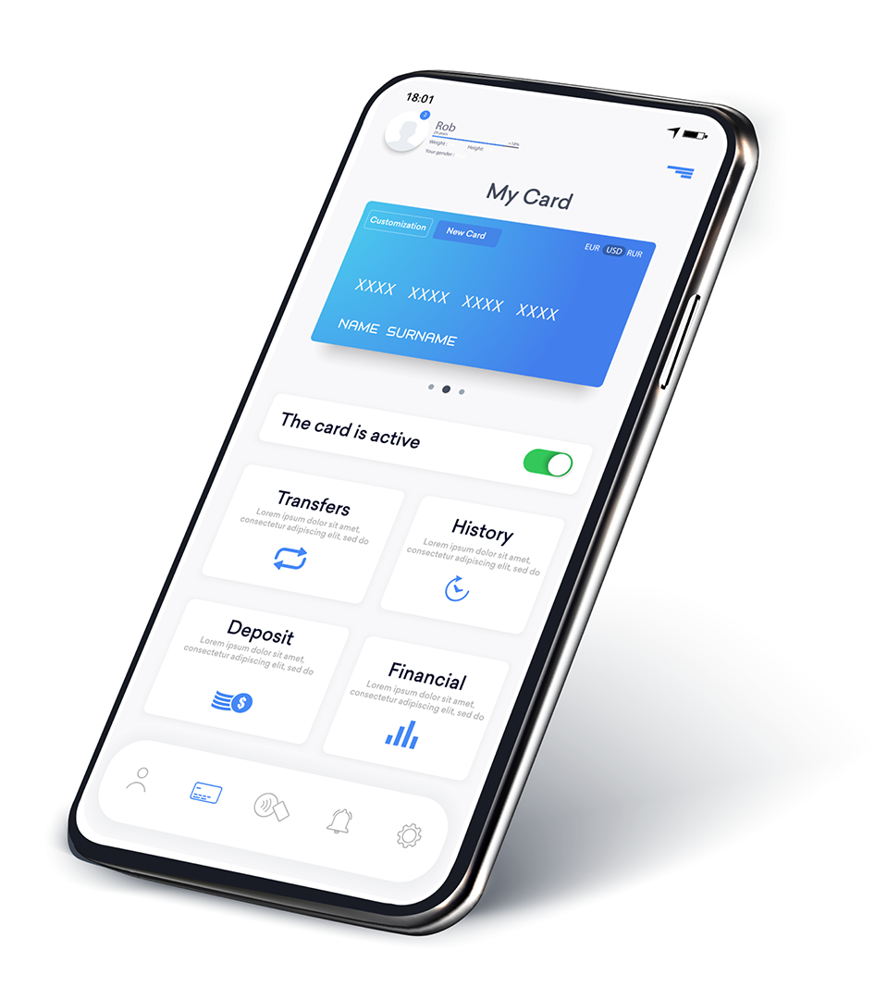
JavaScript Examples
Showing a user personal data only after they log into the application.
Notes:
shutterstock_1968260266

Slide 19
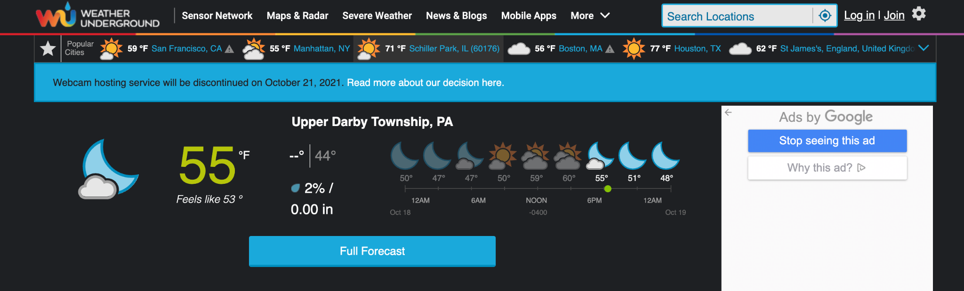
JavaScript Examples
Fetching weather data to display and update on the page.
wunderground.com

Slide 20
JavaScript Examples
Informing users that they are missing information on a form.
Choose your username
I prefer to use my current email address
Create password
Confirm your password
Birthday
@gmail.com
Password strength: Too Short
Use at least 8 characters. Don't use a password from another site, or something too obvious like your pet's name. Why?
Month
Day
Year

Slide 21
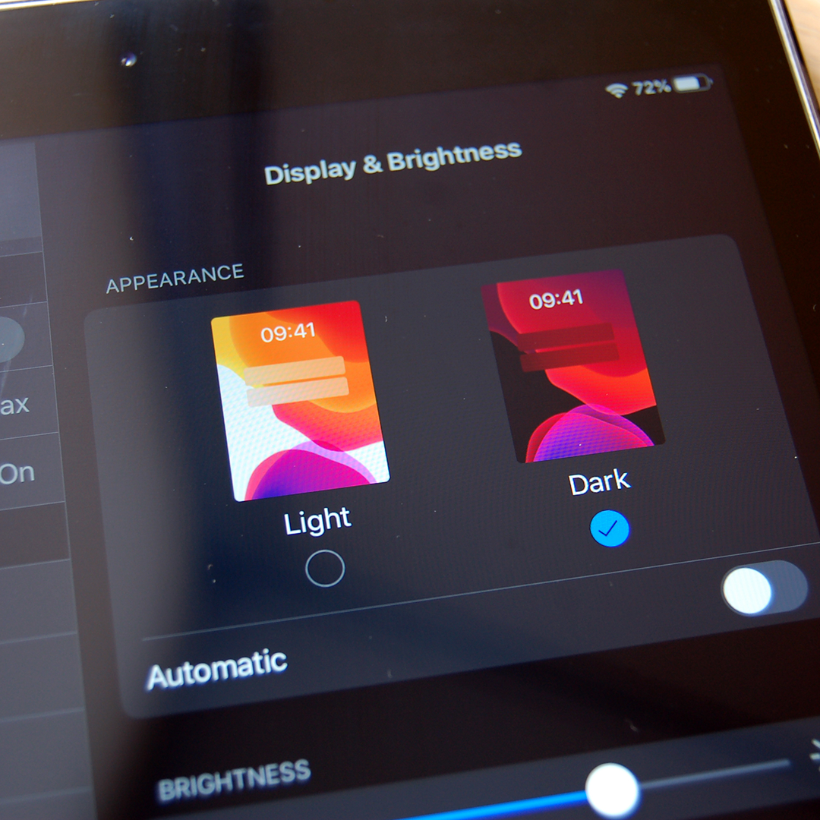
JavaScript Examples
Remembering a user’s preference between light and dark mode themes.
Notes:
shutterstock_1521064613

Slide 22
How can we learn to use JavaScript?

Slide 23
JavaScript
Unlike some other programming languages, JavaScript doesn’t force developers to write code in a specific way. As a result, JavaScript might seem a bit complicated at first, but it can make development work feel incredibly fun and creative as you get to use it more and more.
Var keyword | Variable name | Assignment | Value | Termination
var | character | = | "Snow White" | ;

Slide 24
How to Learn JavaScript
Try some of the following techniques to learn JavaScript:
Read the docs and practice with the provided examples.
Reverse-engineer finished code to see how it was created.
Build something from scratch.
Debug a broken app using Chrome DevTools.
And most importantly, ask questions!

Slide 25
Mini-Project

